Slide 1

PARK PRO
PRESENTED BY
Arun. A (714023104011)
Kavya G (714023104051)
Bhoomash K (714023104015)
Atharsh (714023104013)
Vikram.N
PROJECT GUIDE
Mrs Haritha,
Assistant Professor,
Department of CSE.

Slide 2

PARK PRO
OBJECTIVE:
The objective of "PARK PRO" is to optimize the allocation and utilization of parking spaces in high-demand regions. This system aims to reduce traffic congestion, enhance user convenience by providing real-time information on parking availability, and streamline payment processes. It also seeks to improve the efficiency of parking operations through automation and smart technologies. By offering advanced reservation options and dynamic pricing, the system encourages better space management.
@Sri Shakthi Institution Of Engineering And Technology

Slide 3
PARK PRO
INTRODUCTION:
Parking management is the process of efficiently organizing and regulating parking spaces in busy areas to reduce congestion and improve accessibility.
As urban spaces become more crowded, finding available parking can be a challenge, leading to traffic jams, delays, and frustration for drivers.
well-planned parking management system helps solve these issues by ensuring that parking spaces are used effectively.
@Sri Shakthi Institution Of Engineering And Technology

Slide 4
PARK PRO
Literature review
1. Dynamic Pricing Strategies
Dynamic pricing optimizes parking space utilization by adjusting rates based on demand. Donald Shoup's work highlights its effectiveness in reducing congestion and improving turnover.
2. Technological Innovations
IoT sensors and smart parking apps enhance real-time monitoring, facilitating efficient space usage. Automated systems, like license plate recognition, streamline entry and exit processes.
@Sri Shakthi Institution Of Engineering And Technology

Slide 5
PARK PRO
3. Sustainability Initiatives
Incorporating EV charging stations and promoting shared mobility are vital for reducing urban emissions. Sustainable practices align parking management with broader environmental goals.
4. User-Centric Design
Flexible payment options and reservation systems improve user satisfaction. Understanding user preferences is crucial for effective parking management.
5. Policy and Regulation
Supportive policies and regulations are essential for managing parking supply and demand. Comprehensive policies lead to better traffic conditions and enhanced urban environments.
@Sri Shakthi Institution Of Engineering And Technology

Slide 6
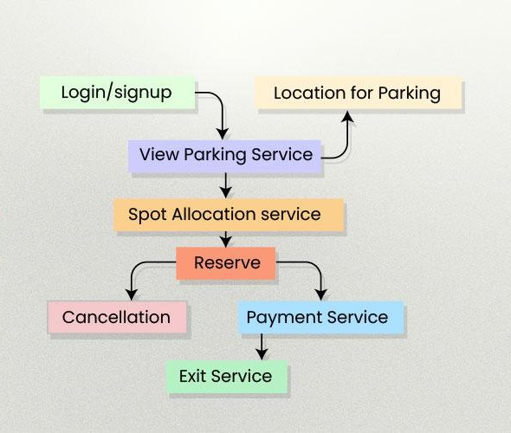
PARK PRO
FLOWCHART
@Sri Shakthi Institution Of Engineering And Technology

Slide 7
PARK PRO
Proposed solution
Implement IoT sensors and a website for real-time parking space monitoring and reservations.
Use a centralized dashboard for management and data analytics to optimize usage.
Integrate automated license plate recognition for seamless entry and exit.
Employ dynamic pricing to adjust rates based on demand and maximize revenue.
Include user feedback features and sustainability options like EV charging stations.
@Sri Shakthi Institution Of Engineering And Technology

Slide 8
PARK PRO
Expected output
Improved user experience with easy access to parking reservations and payments via the website.
Increased efficiency through real-time monitoring and automated entry/exit processes.
Higher revenue generation via dynamic pricing that adjusts based on demand.
Valuable data insights for better decision-making and resource allocation through analytics.
Enhanced sustainability initiatives, including EV charging stations and a focus on eco-friendly options.
@Sri Shakthi Institution Of Engineering And Technology

Slide 9
PARK PRO
Reference​
Abhirup Khanna, Rishi Anand, “IoT based Smart Parking System”, Proc., In 2016 International Conference on Internet of Things and Applications (IOTA), 22 Jan - 24 Jan 2016.
Anusha, Arshitha M, S, Anushri, Geetanjali Bishtannavar “Review Paper on Smart Parking System,” International Journal of Engineering Research & Technology (IJERT), ISSN: 2278-0181, Volume 7, Issue 08, Special Issue – 2019.
S. Senthil, M. Suguna, J. Cynthia, “Mapping the Vegetation Soil and Water Region Analysis of Tuticorin District Using Landsat Images”, IJIEST ISSN (2455-8494), Vol.03, No. 01, Jan 2018 International Journal of Computer Science & Information Technology (IJCSIT) Vol 12, No 4, August 2020
Juhi Seth, Pola Ashritha, R Namith, “Smart Parking System using IoT ElakyaR”, International Journal of Engineering and Advanced Technology (IJEAT), ISSN: 2249 – 8958, Volume-9 Issue-1, October 2019.
@Sri Shakthi Institution Of Engineering And Technology

Slide 10
PARK PRO
queries
Technologies: We will implement IoT sensors for real-time monitoring, a mobile app for user access, and a centralized management dashboard for data analytics.
Payment Handling: User payments will be processed through the app using secure payment gateways, with encryption and compliance with data protection regulations.
Space Utilization Strategies: We will use dynamic pricing, real-time availability updates, and reservation systems to optimize usage and reduce congestion during peak hours.
@Sri Shakthi Institution Of Engineering And Technology

Slide 11


